Slide 1
The Writing on the Wall Bible-Code Series
Notes:
Names Bible Code Acrostic.

Slide 2
The Names Code:
From Adam to Jesus
Notes:
Names Bible Code Acrostic: Adam to Moses.

Slide 3
The Meaning-of-Names code strings together the meanings of every name in the genealogy from Adam all the way to Jesus, 72 persons in all. They compose a revelation of Christ by summarizing major Biblical events that foreshadow Him.
Notes:
The revelation in the names code is both by and about Jesus Christ.
(Rev 1:1) “The Revelation of Jesus Christ, which God gave him to show unto his servants, even the things which must shortly come to pass: and he sent and signified it by his angel unto his servant John.”

Slide 4
Please see website (www.bible-codes.org) for the methodology here used, and for the meaning of each name in great detail. We start with “God” in the genealogy of Jesus just as the Gospel of Luke does. Luke calls Adam, “The son of God”, thus making God the beginning point in Jesus’ genealogy. Luke 3:38

Slide 5
Seth --- is appointed,
Enosh --- a mortal man of
Kenan --- sorrow is born!
Mahalalel --- The Glory of God
Jared --- shall come down
Enoch --- instructing that
God --- The God-
Methuselah --- His death shall bring
Adam --- Man
Lamech --- those in despair
Noah --- comfort and rest!
Notes:
See Isaiah 9:6: The bible itself tells the reader what some of these names mean. For example, Noah’s name means “rest” (“נוח“) in Hebrew, but also sounds like another Hebrew word for “comfort” (“נחם”):
(Gen. 5:29) “Lamech called his name Noah, saying, This same shall comfort us in our work and in the toil of our hands, which cometh because of the ground which Jehovah hath cursed.”

Slide 6
Cainan (LXX) --- and sorrow
Shelah --- extend like a plant
Eber --- beyond the place of
Peleg --- division (at the Tower of Babel).
Reu --- A friend
Serug --- (also) branches out,
Shem --- The fame of
Nahor --- enraged
Arphaxad --- Babylon’s fortress (but I will make Babylon fade away!)
Terah --- with fury!
Notes:
Both Abraham and Moses are called, “a friend of God”. (Ex. 33:11; 2Chron. 20:7.) But Jesus called both the friend and “the branch”, and it is he who ultimately will destroy the forces of evil in His great wrath.
Jer 23:5 “Behold, the days come, saith the LORD, that I will raise unto David a righteous Branch, and a King shall reign and prosper, and shall execute judgment and justice in the earth.”
Jer 23:6 “In his days Judah shall be saved, and Israel shall dwell safely: and this [is] his name whereby he shall be called, THE LORD OUR RIGHTEOUSNESS.”

Slide 7
Jacob --- as he outwits (his enemy).
Levi --- (then) joins himself to
Kohath --- an assembly,
Amram --- a glorious people
Moses --- (whom) he rescued,
Gershom -- stranger(s) in a strange land,
(Abraham) --- the father of a multitude,
Abram --- A glorious father,
Shebuel --- captives delivered by God!
Isaac --- laughs
(Israel) --- A mighty prince sees God
These 6 names branch off into Moses’ line, not Christ’s. But clearly they join the main names code as evident by their perfect fit with the whole. (And they “join” at Levi, which means “join”!)
The code still reads well without these six.
Notes:
Isaiah the prophet calls Jesus, “the everlasting father” in Isa 9:6. “For unto us a child is born, unto us a son is given; and the government shall be upon his shoulder: and his name shall be called Wonderful Counselor, Mighty God, Everlasting Father, Prince of Peace. “ The other names in Isaiah are also present.

Slide 8
Hezron --- an area surrounded by a wall
Ram --- of great height.
Amminadab --- O’ my people who belong to the Prince,
Nahshon --- a prophet
Salmon --- clothed
Boaz --- with strength,
Judah --- One who praises the Lord
Perez --- breaks open a way (into)
Obed --- who serves (the Lord),
Jesse --- is here!
David --- one well-loved,
Solomon --- peaceful,
Rehoboam --- and who sets the people free.
Notes:
Judah means, “Praise” , and the tribe of Judah lead the way for Israel into the Promised Land. They were shielded by “a wall of great height” along the way, that is, “a pillar of cloud by day and a pillar of fire by night.” Moses is their leader and prince. The “wall of great of height” may also refer to the “great and high wall” around the New Jerusalem in the last day, (Rev. 21:12).
Rev 21:10-12 “And he carried me away in the Spirit to a mountain great and high, and showed me the holy city Jerusalem, coming down out of heaven from God,
Rev 21:11 having the glory of God: …
Rev 21:12 having a wall great and high…

Slide 9
Jehoshaphat --- him whom the Lord judged
Abijah --- My father is the Lord,
Asa --- the healer of
Jehoram --- and whom the Lord raised up!
Amaziah --- Mighty is the Lord!
Joash --- and the Lord is strong!
Ahaziah --- The Lord took hold (of me)
Manasseh --- It made (me) forget (my misery).
Hezekiah --- the strength of the Lord.
Ahaz --- I took hold of
Jotham --- The Lord is perfect!
Uzziah/Azariah -- My strength and help are in the Lord!
Notes:
Exo. 2:14 And he said, Who made thee a prince and a judge over us?
Act 5:30-31 “The God of our fathers raised up Jesus, whom ye slew, hanging him on a tree.
Him did God exalt with his right hand to be a Prince and a Saviour, to give repentance to Israel, and remission of sins.“
Manasseh, (GNB – Gen. 41:51) “(Jacob) said, "God has made me forget all my sufferings and all my father's family"; so he named his first son Manasseh.”

Slide 10
Jehoiakim/Eliakim --- whom the Lord God raised up,
Jeconiah --- whom the Lord upholds,
Shealtiel --- I have asked God about
Pedaiah --- the ransomed of the Lord,
Zerubbabel --- the exiles who are in Babylon.
Amon --- Truly, (I am) the master builder
Josiah --- whom the Lord healed,
Jehoiachin --- and will uphold!
Coniah --- did uphold
Notes:
Heb 11:10 “…for he looked for the city which hath the foundations, whose builder and maker is God.” Psa 30:1-2 “I will extol thee, O Jehovah; for thou hast raised me up, And hast not made my foes to rejoice over me. O Jehovah my God, I cried unto thee, and thou hast healed me.”
Gen 4:25 “And Adam knew his wife again; and she bare a son, and called his name Seth. For, said she, God hath appointed me another seed instead of Abel; for Cain slew him.”
Isa 35:10 And the ransomed of the LORD shall return, and come to Zion with songs and everlasting joy upon their heads: they shall obtain joy and gladness, and sorrow and sighing shall flee away.

Slide 11
Jacob --- Jacob
Joseph --- increase (in greatness)!
Emmanuel --- For God is with us,
Abiud --- My Father is glorious!
Eleazar --- God will help!
Eliud --- My God is my praise!
Eliakim --- My God will raise up
Azor --- a helper,
Akim --- will the Lord raise up!
Church --- those called out of (Babylon).
Zadok --- the Just (One)
Matthan --- May the gift of
Jesus Christ --- the Messiah and Savior of
Notes:
(Eph. 1:17) “I ask the glorious Father and God of our Lord Jesus Christ to give you his Spirit…”
Act 7:52 “Which of the prophets have not your fathers persecuted? and they have slain them which shewed before of the coming of the Just One; of whom ye have been now the betrayers and murderers.”
(Ps. 109:1) “Hold not thy peace, O God of my praise;”
(Ps. 54:4) “For behold God is my helper: and the Lord is the protector of my soul.”
(Eph 2:8-9) “for by grace have ye been saved through faith; and that not of yourselves, it is the gift of God;”
(Isa 9:6) “For unto us a child is born, unto us a son is given; and the government shall be upon his shoulder: and his name shall be called Wonderful, Counsellor, Mighty God, Everlasting Father, Prince of Peace.
The name “Jacob” is not rendered because here it is simply meant to be another name for the people of Israel. (Jacob and Israel are used interchangeably in the bible.)
(Isa 9:7) Of the increase of his government and of peace there shall be no end, upon the throne of David, and upon his kingdom, to establish it, and to uphold it with justice and with righteousness from henceforth even for ever.”
(1Peter 2:9) “But you are a chosen people, a royal priesthood, a holy nation, a people to be his very own and to proclaim the wonderful deeds of the one who called you out of darkness into his marvelous light.”

Slide 12
The Acrostic Code:
From
Adam to Abraham
Notes:
Acrostic: Adam to Noah to Abraham (and even to Moses, as explained on website).

Slide 13
A lengthy acrostic has also been discovered in the genealogy from Adam to Abraham.
Notes:
Lengthy Bible Code Acrostic.

Slide 14
The first letter of each consecutive Hebrew name from Adam to Abraham reads: "I will forgive my enemies, having compassion, forgiving those made from dust once again.
Notes:
Adam to Abraham.

Slide 15
Gen. 5 Gen. 11

Slide 16
אשא קמי חמל
Enosh
אנוש
Kenan
Mahalalel
Jared
Enoch
Methuselah
Seth
שת
קינן
מהללאל
ירד
חנוך
אדם
Adam
מתושלח
Lamech
למך
Gen. 5
I will forgive my enemies, showing compassion,
Notes:
What it says…

Slide 17
נשא שעפר שנת
Shelah
שלח
Eber
Peleg
Reu
Serug
Nahor
Arphaxad
ארפכשד
עבר
פלג
רעו
שרוג
שם
Shem
נחור
Terah
תרח
נח
Noah
Gen. 11
forgiving what is of dust once again.
Notes:
What it says…

Slide 18
The ungodly line of Cain Gen. 4

Slide 19
The Bible also records for us the ungodly line of Cain. Amazingly, it reads in agreement with the acrostic derived from the godly line of Adam to Abraham, as just explained. Both carry the theme of “a chosen people”.

Slide 20
עממ לי אקח
Enoch
חנוך
Irad
Mejujael
Methusael
Lamech
Jabal
Cain
קין
מחייאל
מתושאל
למך
אדם
Adam
יבל
עירד
Cain’s line can read two ways…
עמ מלי אקח
“I will choose a people, my circumcised ones.”
or
“I will choose peoples for myself.”
Notes:
Cain's line.

Slide 21
A close look at the first part of the acrostic --- from Adam to the father of Abraham.
Notes:
From Adam to the father of Abraham.

Slide 22
The acrostic from the first 19 names of Adam to Abraham’s father forms a stairway-pattern. The last letter of each Hebrew word begins the next word, and so forth.
Notes:
Stairway acrostic: Stairway pattern.

Slide 23
The stairway pattern reminds us of the Tower of Babel, an event recorded for us immediately before this genealogy. Gen. 11

Slide 24
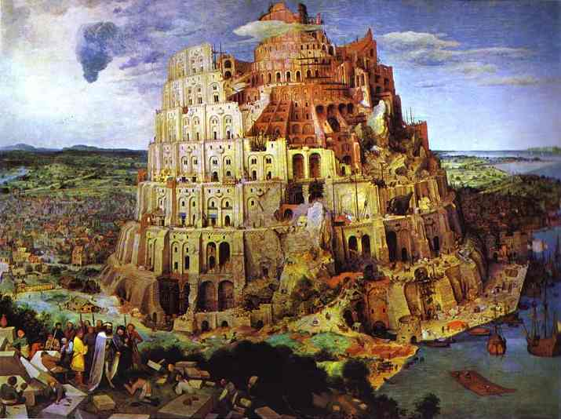
ת | נ | ש | ר | פ | ע | ש | א | ש | נ | ל | מ | ח | י | מ | ק | א | ש | א
 |  |  |  |  |  |  |  |  |  |  |  |  |  |  |  | א | ש | א
 |  |  |  |  |  |  |  |  |  |  |  |  |  | מ | ק | א
 |  |  |  |  |  |  |  |  |  |  |  |  | י | מ
 |  |  |  |  |  |  |  |  |  | ל | מ | ח | י
 |  |  |  |  |  |  | א | ש | נ | ל
 |  |  |  |  | ע | ש | א
 |  |  | ר | פ | ע
 |  | ש | ר
ת | נ | ש
Notes:
At the Tower of Babel men attempted to reach up to the God of heaven! But instead God reached down to save man!

Slide 25
This “stairway” is derived from the acrostic and enlarges the acrostic by elaborating on it.

Slide 26
I will arise! I will be raised up!
To whom will he show compassion?
Upon the Risen One will I look with favor, upon the dust of a poor man
a second time!
ת | נ | ש | ר | פ | ע | ש | א | ש | נ | ל | מ | ח | י | מ | ק | א | ש | א
 |  |  |  |  |  |  |  |  |  |  |  |  |  |  |  | א | ש | א
 |  |  |  |  |  |  |  |  |  |  |  |  |  | מ | ק | א
 |  |  |  |  |  |  |  |  |  |  |  |  | י | מ
 |  |  |  |  |  |  |  |  |  | ל | מ | ח | י
 |  |  |  |  |  |  | א | ש | נ | ל
 |  |  |  |  | ע | ש | א
 |  |  | ר | פ | ע
 |  | ש | ר
ת | נ | ש
Notes:
What the letters read in the stairway.

Slide 27
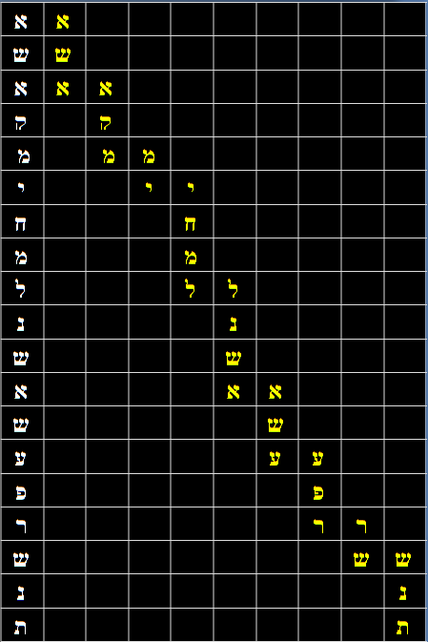
I will forgive
I will arise! I will be raised up!
To whom will he show compassion?
Upon the Risen One will I look with favor, upon the dust of a poor man
a second time!
I will forgive my enemies, having compassion, forgiving what is dust a second time.

Slide 28
I will arise! I will be raised up!
To whom will he show compassion?
Upon the Risen One will I look with favor, upon the dust of a poor man
a second time!
my enemies,
I will forgive my enemies, having compassion, forgiving what is dust a second time.

Slide 29
I will arise! I will be raised up!
To whom will he show compassion?
Upon the Risen One will I look with favor, upon the dust of a poor man
a second time!
I will forgive my enemies, having compassion, forgiving what is dust a second time.
having compassion,

Slide 30
I will arise! I will be raised up!
To whom will he show compassion?
Upon the Risen One will I look with favor, upon the dust of a poor man
a second time!
I will forgive my enemies, having compassion, forgiving what is dust a second time.
forgiving

Slide 31
I will arise! I will be raised up!
To whom will he show compassion?
Upon the Risen One will I look with favor, upon the dust of a poor man
a second time!
I will forgive my enemies, having compassion, forgiving what is dust a second time.
what is dust

Slide 32
I will arise! I will be raised up!
To whom will he show compassion?
Upon the Risen One will I look with favor, upon the dust of a poor man
a second time!
I will forgive my enemies, having compassion, forgiving what is dust a second time.
a second time!

Slide 33
I will arise!
I will be raised up!
To whom will he show compassion?
Upon the Risen One will I look with favor,
upon the dust of a poor man
a second time!
I will arise!
I will forgive my enemies, having compassion, forgiving what is dust a second time.

Slide 34
I will arise!
I will be raised up!
To whom will he show compassion?
Upon the Risen One will I look with favor,
upon the dust of a poor man
a second time!
I will be raised up!
I will forgive my enemies, having compassion, forgiving what is dust a second time.

Slide 35
I will arise!
I will be raised up!
To whom will he show compassion?
Upon the Risen One will I look with favor,
upon the dust of a poor man
a second time!
I will arise! I will be raised up!
To whom will he show compassion?
Upon the Risen One will I look with favor, upon the dust of a poor man
a second time!
Whom
I will forgive my enemies, having compassion, forgiving what is dust a second time.

Slide 36
I will arise!
I will be raised up!
To whom will he show compassion?
Upon the Risen One will I look with favor,
upon the dust of a poor man
a second time!
I will arise! I will be raised up!
To whom will he show compassion?
Upon the Risen One will I look with favor, upon the dust of a poor man
a second time!
I will forgive my enemies, showing compassion, forgiving what is dust a second time.
will he show compassion?

Slide 37
I will arise!
I will be raised up!
To whom will he show compassion?
Upon the Risen One will I look with favor,
upon the dust of a poor man
a second time!
I will arise! I will be raised up!
To whom will he show compassion?
Upon the Risen One will I look with favor, upon the dust of a poor man
a second time!
I will forgive my enemies, having compassion, forgiving what is dust a second time.
Upon the risen one

Slide 38
I will arise!
I will be raised up!
To whom will he show compassion?
Upon the Risen One will I look with favor,
upon the dust of a poor man
a second time!
I will arise! I will be raised up!
To whom will he show compassion?
Upon the Risen One will I look with favor, upon the dust of a poor man
a second time!
I will forgive my enemies, having compassion, forgiving what is dust a second time.
I will look with favor,

Slide 39
I will arise!
I will be raised up!
To whom will he show compassion?
Upon the Risen One will I look with favor,
upon the dust of a poor man
a second time!
I will arise! I will be raised up!
To whom will he show compassion?
Upon the Risen One will I look with favor, upon the dust of a poor man
a second time!
I will forgive my enemies, having compassion, forgiving what is dust a second time.
(upon)
dust of

Slide 40
I will arise!
I will be raised up!
To whom will he show compassion?
Upon the Risen One will I look with favor,
upon the dust of a poor man
a second time!
I will arise! I will be raised up!
To whom will he show compassion?
Upon the Risen One will I look with favor, upon the dust of a poor man
a second time!
I will forgive my enemies, having compassion, forgiving what is dust a second time.
a poor man

Slide 41
I will arise!
I will be raised up!
To whom will he show compassion?
Upon the Risen One will I look with favor,
upon the dust of a poor man
a second time!
I will arise! I will be raised up!
To whom will he show compassion?
Upon the Risen One will I look with favor, upon the dust of a poor man
a second time!
I will forgive my enemies, having compassion, forgiving what is dust a second time.
a second time!

Slide 42
It is interesting that the stairway acrostic begins with the letter “Aleph” and ends with the letter “Tav”, which are the first and last letters of the Hebrew alphabet. This corresponds to “Alpha and Omega” in Greek.
Notes:
Alpha at Omega!

Slide 43
ת | נ | ש | ר | פ | ע | ש | א | ש | נ | ל | מ | ח | י | מ | ק | א | ש | א
 |  |  |  |  |  |  |  |  |  |  |  |  |  |  |  | א | ש | א
 |  |  |  |  |  |  |  |  |  |  |  |  |  | מ | ק | א
 |  |  |  |  |  |  |  |  |  |  |  |  | י | מ
 |  |  |  |  |  |  |  |  |  | ל | מ | ח | י
 |  |  |  |  |  |  | א | ש | נ | ל
 |  |  |  |  | ע | ש | א
 |  |  | ר | פ | ע
 |  | ש | ר
ת | נ | ש
Notes:
Alpha to Omega --- At the Tower of Babel men attempted to reach up to the God of heaven! But instead God reached down to save man!

Slide 44
See www.bible-codes.org for “The Names Code”

