Slide 1

Names Code
From Adam to Jesus
Date: 2009
By: Dean Coombs
www.bible-codes.org

Slide 2
Names Code
The meanings of all 72 names from Adam to Jesus read sequentially.

Slide 3
The Names Code
The meaning of a name was very important in bible days. The bible itself informs the reader what the meaning of many biblical persons are, men of renown such as Adam, Cain, Seth, Noah, Abraham, Isaac, Jacob and all his 12 sons. Their names tell the story of why or how they were born.
Some have wondered if these names (with their meanings) were intended by God to be strung together in chronological succession to tell some larger story. Already, the first 10 names in the bible from Adam to Noah have been strung together. But do they continue to read like this all the way to Jesus, 72 persons in all?

Slide 4
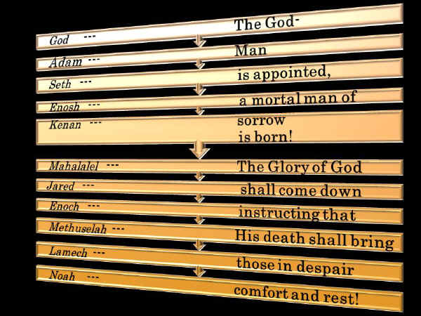
Meanings of first 10 names from Adam to Noah read sequentially [Part 1]
"The God-man is appointed, a mortal man of sorrow is born! The Glory of God shall come down and teach that His death shall bring the grieving comfort and rest."

Slide 5
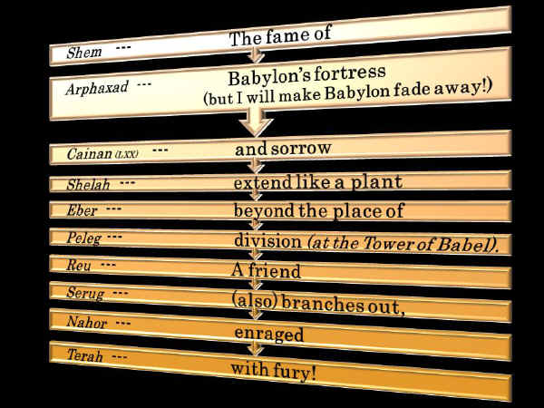
Shem to Terah [Part 2]

Slide 6
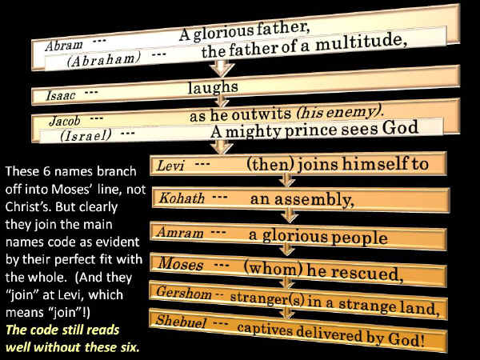
Abraham to Israel [Part 3]

Slide 7
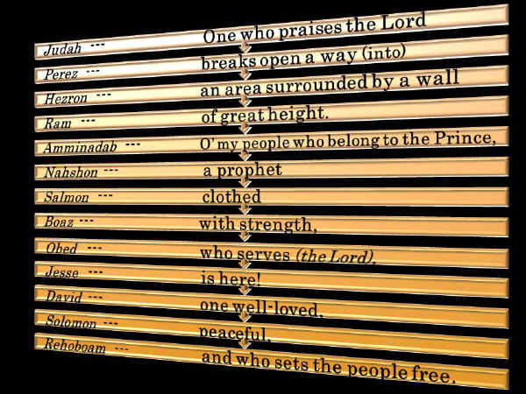
Judah to Solomon’s Son [Part 4]

Slide 8
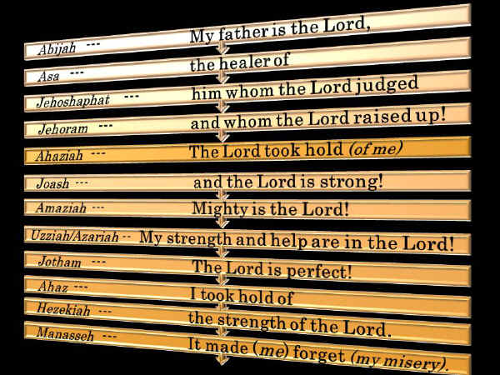
Abijah to Manasseh [Part 5]

Slide 9
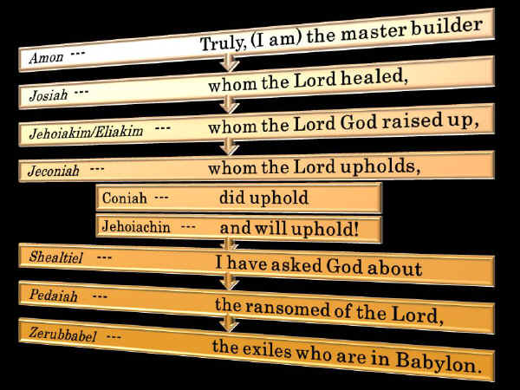
Amon to Zerubbabel [Part 6]

Slide 10
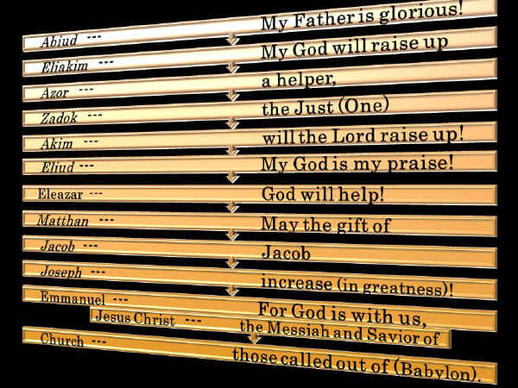
Abiud to Jesus [Part 7]

Slide 11
The Acrostic Code: Adam to Abraham
A lengthy acrostic has also been discovered in the genealogy from Adam to Terah, the father of Abraham.

Slide 12
"I will forgive my enemies, having compassion, forgiving those made from dust once again.”
What the Acrostic Reads
Notes:
Adam to Moses.

Slide 13
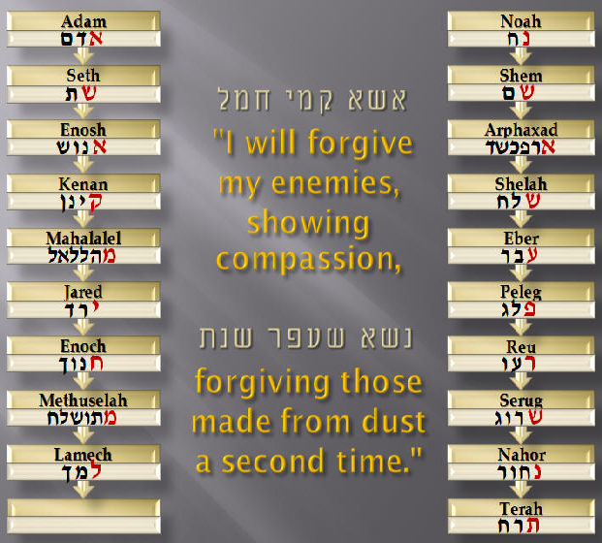
Gen. 5 Gen. 11

Slide 14
אשא קמי חמל
Acrostic: Adam to Noah’s Father [Gen. 5]
Enosh
אנוש
Kenan
Mahalalel
Jared
Enoch
Methuselah
Seth
שת
קינן
מהללאל
ירד
חנוך
אדם
Adam
מתושלח
Lamech
למך
“I will forgive my enemies, showing compassion…
Notes:
What it says…

Slide 15
נשא שעפר שנת
Acrostic: Noah to Abraham’s Father [Gen. 11]
Shelah
שלח
Eber
Peleg
Reu
Serug
Nahor
Arphaxad
ארפכשד
עבר
פלג
רעו
שרוג
שם
Shem
נחור
Terah
תרח
נח
Noah
…forgiving what is
from dust once again.”
Notes:
What it says…

Slide 16
Researchers Bio-Sketch
Researched by: Dean Thomas Coombs
  Bachelors of Theology from Eastern Pentecostal Bible College , (Peterborough, Ontario), (1980-85)
  One year at Ontario Theological Seminary (Toronto, Ontario), (1985-1986)
  The study into bible numbers and codes began 1991
  www.bible-codes.org

